Slide 2
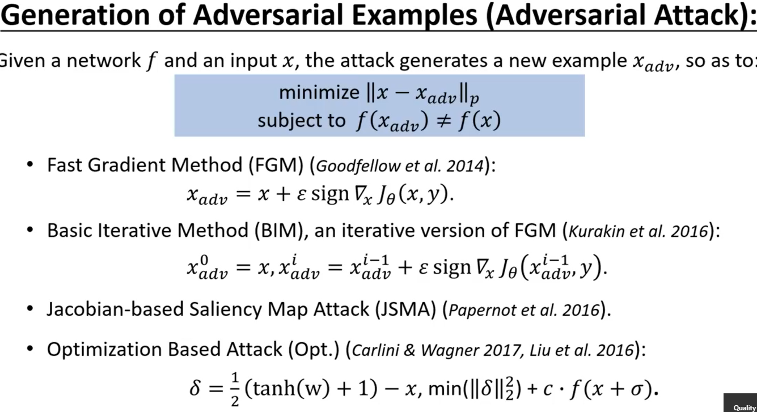
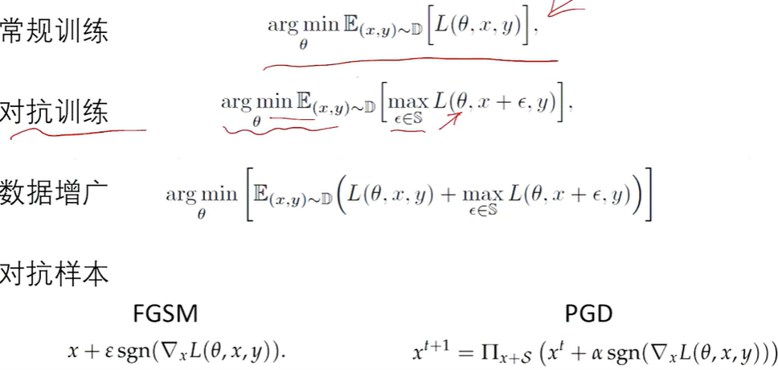
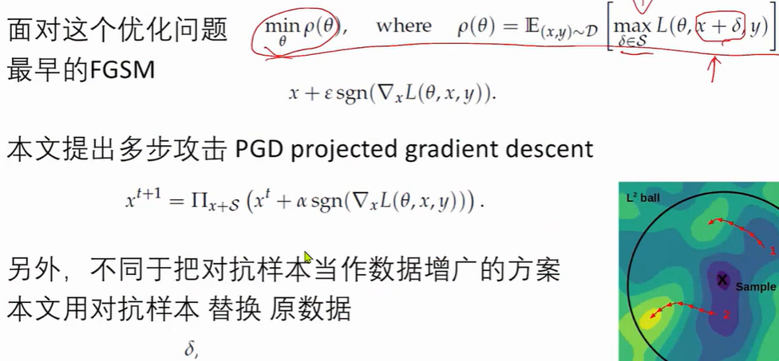

Slide 3
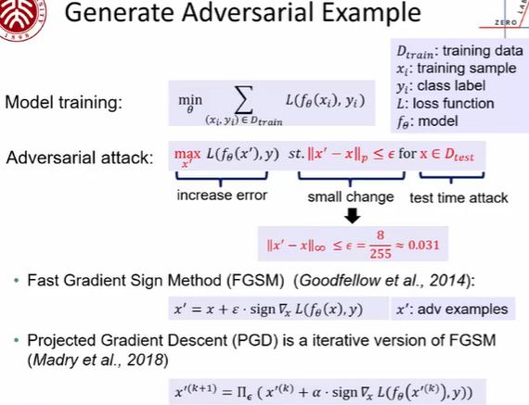
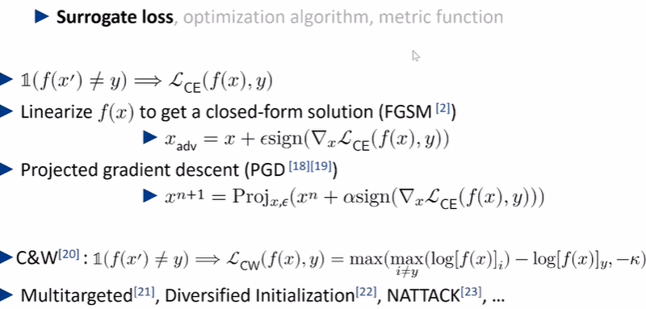
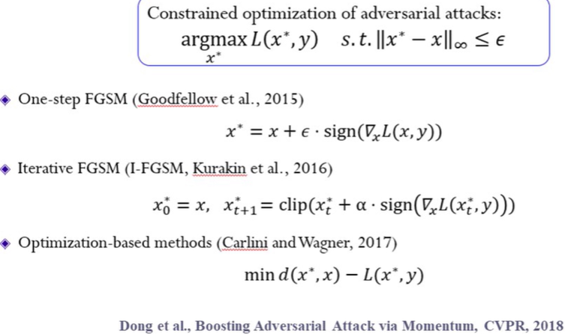
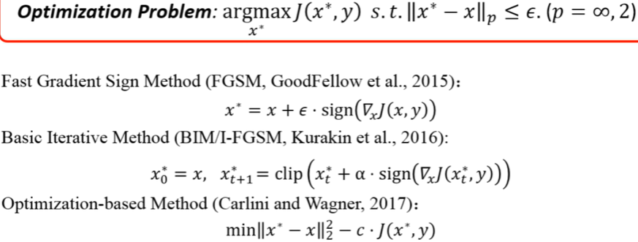
Simplify Description of PGD
Notes:
智源论坛Live丨清华大学董胤蓬：深度学习对抗攻防平台
PGD random init?

Slide 4
21. What is the Exploration - Exploitation dilemma?
A. Find Balance between Exploration, to take greedy action to maximize reward, and Exploitation, to try new and unknown states and actions.
B. Play the game and observe the rewards we get
C. Use our current knowledge about which action seems to produce the most rewards, and always pick that action.
D. Find Balance between Exploration, to try new and unknown states and actions, and Exploitation, to take greedy action to maximize reward.
ANS: ________________

Slide 5
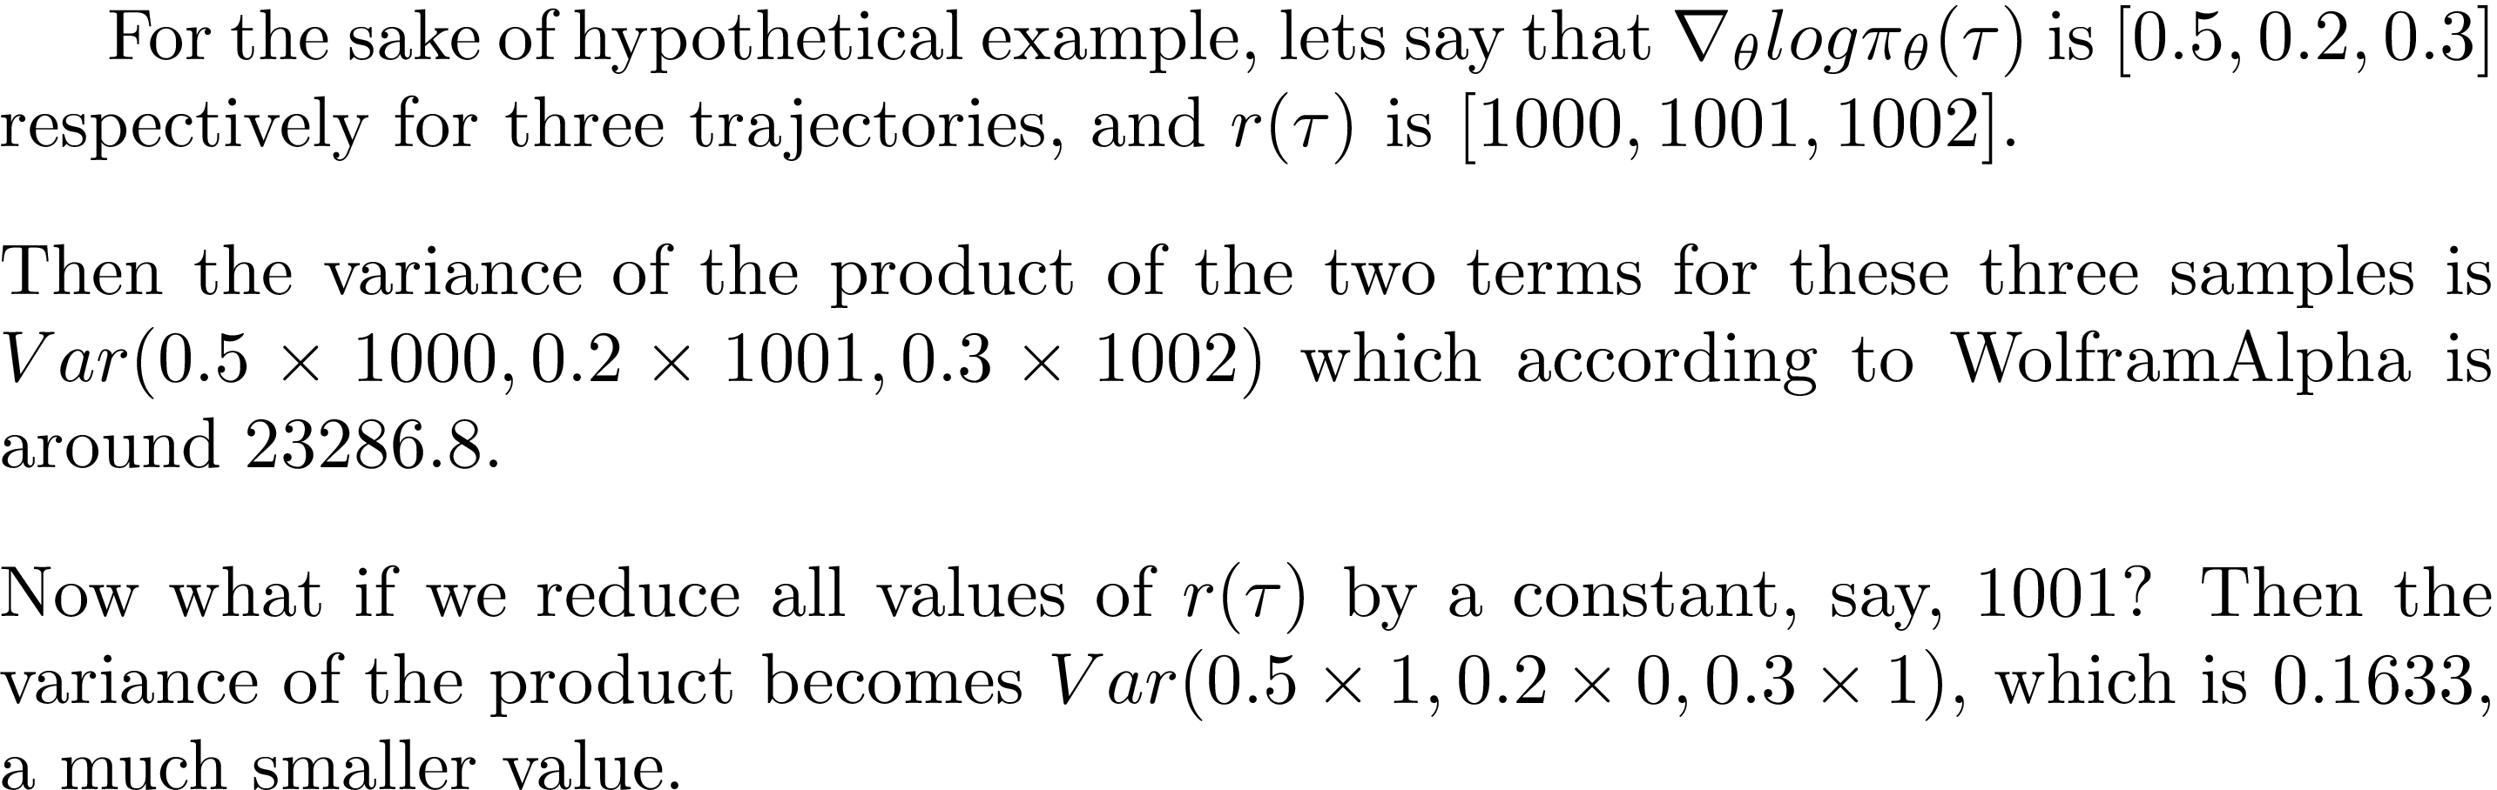
Reduce Variance
Assume

Slide 6
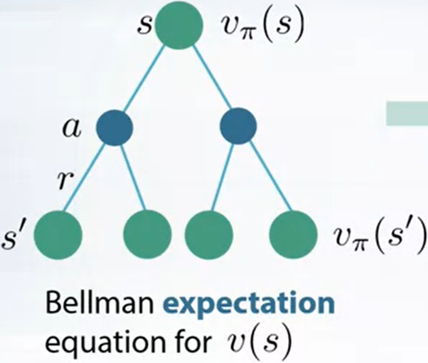
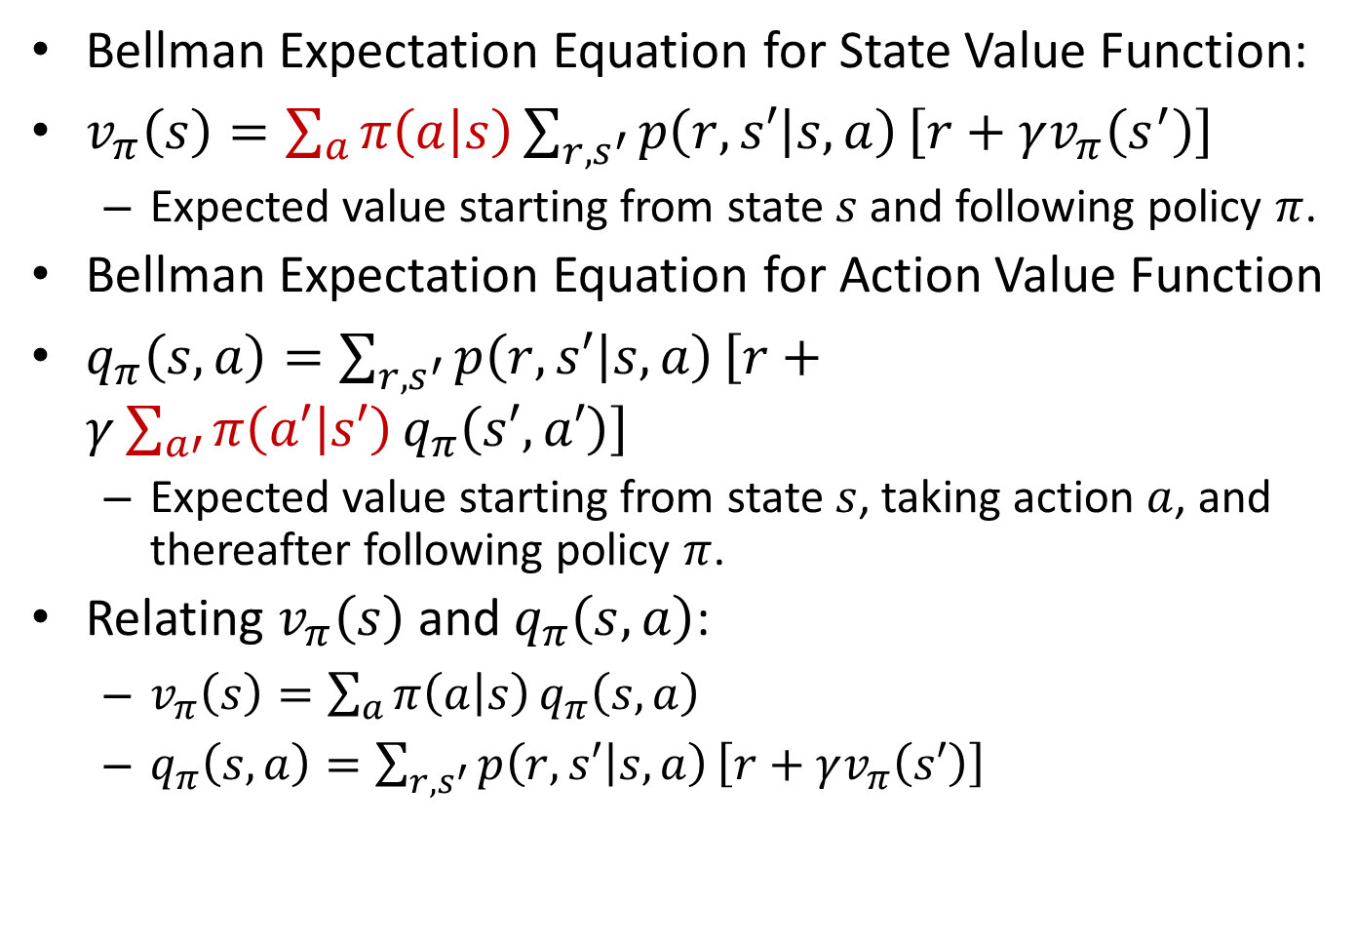
Bellman Expectation Equations
Important
Bellman Expectation Equation for State Value Function:
$v_{π}\left(s\right)=\sum_{a}{π\left(a | s\right)}\sum_{r,s^{′}}{p\left(r,s′ | s,a\right)}\left[r+γv_{π}\left(s^{′}\right)\right]$
Expected value starting from state $s$ and following policy $π$.
Bellman Expectation Equation for Action Value Function
$q_{π}\left(s,a\right)=\sum_{r,s^{′}}{p\left(r,s′ | s,a\right)}\left[r+γ\sum_{a′}{π\left(a′ | s′\right)}q_{π}\left(s′,a′\right)\right]$
Expected value starting from state $s$, taking action $a$, and thereafter following policy $π$.
Relating $v_{π}\left(s\right)$ and $q_{π}\left(s,a\right)$:
$v_{π}\left(s\right)=\sum_{a}{π\left(a | s\right)}q_{π}\left(s,a\right)$
$q_{π}\left(s,a\right)=\sum_{r,s^{′}}{p\left(r,s′ | s,a\right)}\left[r+γv_{π}\left(s′\right)\right]$
Notes:
$=𝔼_{π}[R_{t+1}+γv_{π}(S_{t+1})|S_{t}=s]$ $=𝔼_{π}[R_{t+1}+γv_{π}(S_{t+1})|S_{t}=s, A_{t}=a]$

Slide 7
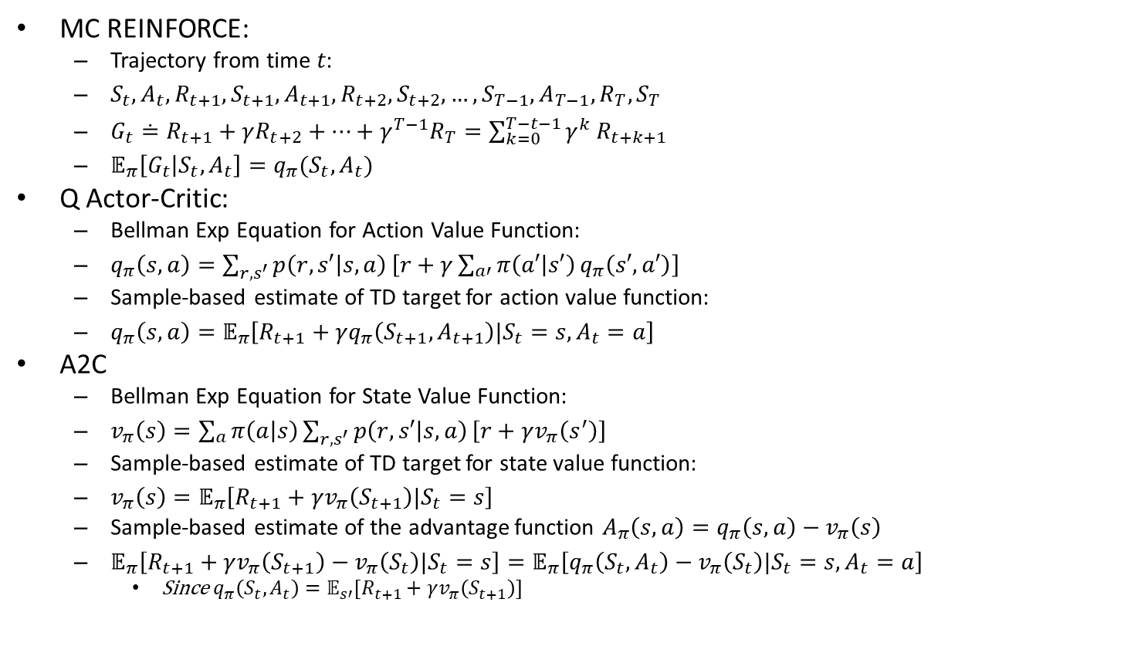
Further Explanations
MC REINFORCE:
Trajectory from time $t\text{:}$
$S_{t},A_{t},R_{t+1},S_{t+1}, A_{t+1},R_{t+2},S_{t+2},…,S_{T−1},A_{T−1},R_{T},S_{T}$
$G_{t}≐R_{t+1}+γR_{t+2}+…+γ^{T−1}R_{T}=\sum_{k=0}^{T−t−1}{γ^{k}}R_{t+k+1}$
$𝔼_{π}\left[G_{t} | S_{t},A_{t}\right]=q_{π}(S_{t},A_{t})$
Q Actor-Critic:
Bellman Exp Equation for Action Value Function:
$q_{π}\left(s,a\right)=\sum_{r,s^{′}}{p\left(r,s′ | s,a\right)}\left[r+γ\sum_{a′}{π\left(a′ | s′\right)}q_{π}\left(s′,a′\right)\right]$
Sample-based estimate of TD target for action value function:
$q_{π}\left(s,a\right)=𝔼_{π}\left[R_{t+1}+γq_{π}\left(S_{t+1},A_{t+1}\right)|S_{t}=s, A_{t}=a\right]$
A2C
Bellman Exp Equation for State Value Function:
$v_{π}\left(s\right)=\sum_{a}{π\left(a | s\right)}\sum_{r,s^{′}}{p\left(r,s′ | s,a\right)}\left[r+γv_{π}\left(s^{′}\right)\right]$
Sample-based estimate of TD target for state value function:
$v_{π}\left(s\right)=𝔼_{π}\left[R_{t+1}+γv_{π}\left(S_{t+1}\right)|S_{t}=s\right]$
Sample-based estimate of the advantage function $A_{π}\left(s,a\right)=q_{π}\left(s,a\right)−v_{π}\left(s\right)$
$𝔼_{π}\left[R_{t+1}+γv_{π}\left(S_{t+1}\right)−v_{π}\left(S_{t}\right)|S_{t}=s\right]=𝔼_{π}\left[q_{π}\left(S_{t},A_{t}\right)−v_{π}\left(S_{t}\right)|S_{t}=s, A_{t}=a\right]$
Since $q_{π}\left(S_{t},A_{t}\right)=𝔼_{s′}[R_{t+1}+γv_{π}\left(S_{t+1}\right)]$
https://www.cellstrat.com/2020/03/19/rl-with-actor-critic-methods/
https://www.cellstrat.com/2020/03/19/rl-with-actor-critic-methods/
Notes:
Expected value starting from state $s$ and following policy $π$.

Slide 8
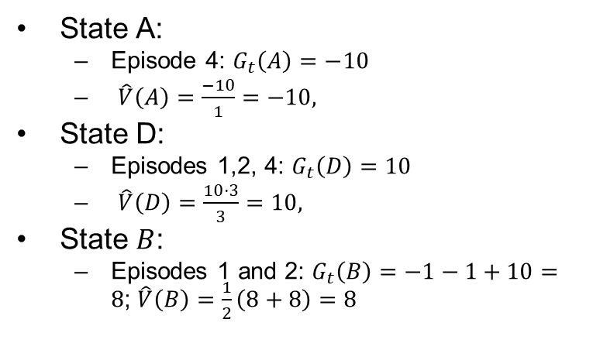
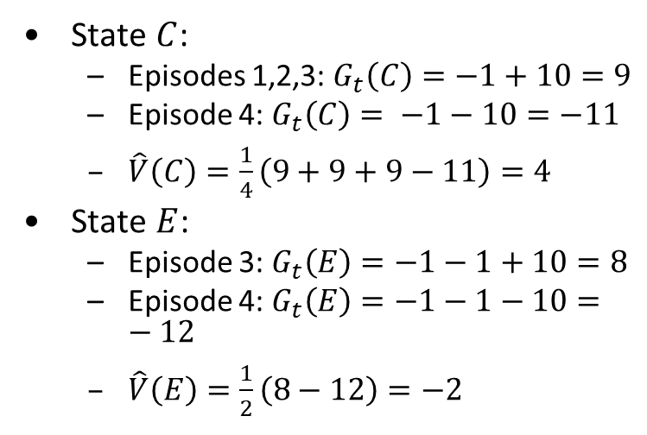
MC Prediction for MiniGW
Input Policy π
Observed Episodes (Training)
Output Values
Episode 1
Episode 2
-10
 | A
B | C | D
 | E
B, east, C, -1
C, east, D, -1
D, exit, x, +10
B, east, C, -1
C, east, D, -1
D, exit, x, +10
 | A
B | C | D
 | E
+8
+4
+10
Episode 3
Episode 4
E, north, C, -1
C, east, D, -1
D, exit, x, +10
E, north, C, -1
C, east, A, -1
A, exit, x, -10
-2
Assume: γ = 1
State A:
Episode 4: $G_{t}\left(A\right)=−10$
$\hat{V}\left(A\right)=\frac{−10}{1}=−10,$
State D:
Episodes 1,2, 4: $G_{t}\left(D\right)=$ $10$
$\hat{V}\left(D\right)=\frac{10⋅3}{3}=10,$
State $B$:
Episodes 1 and 2: $G_{t}\left(B\right)=$ $−1−1+10=8$; $\hat{V}\left(B\right)=\frac{1}{2}\left(8+8\right)=8$
State $C$:
Episodes 1,2,3: $G_{t}\left(C\right)=−1+10=9$
Episode 4: $G_{t}\left(C\right)= −1−10=−11$
$\hat{V}\left(C\right)=\frac{1}{4}\left(9+9+9−11\right)=4$
State $E$:
Episode 3: $G_{t}\left(E\right)=−1−1+10=8$
Episode 4: $G_{t}\left(E\right)=−1−1−10=−12$
$\hat{V}\left(E\right)=\frac{1}{2}\left(8−12\right)=−2$
Is G_t(S) proper notation?
Notes:
This is called MCTS

Slide 9
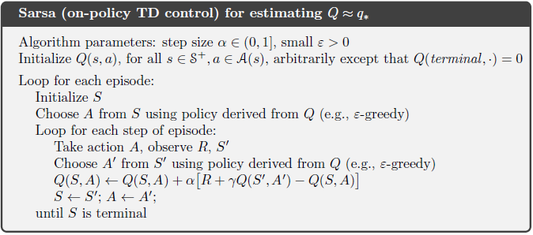
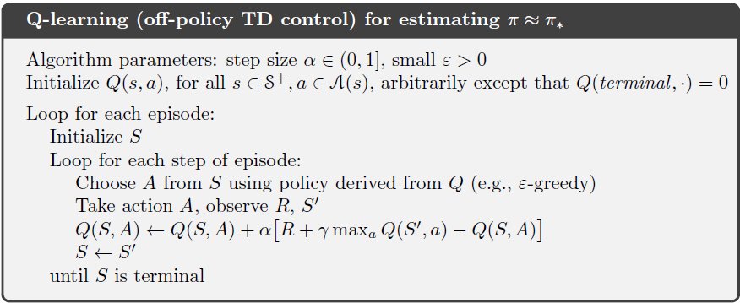
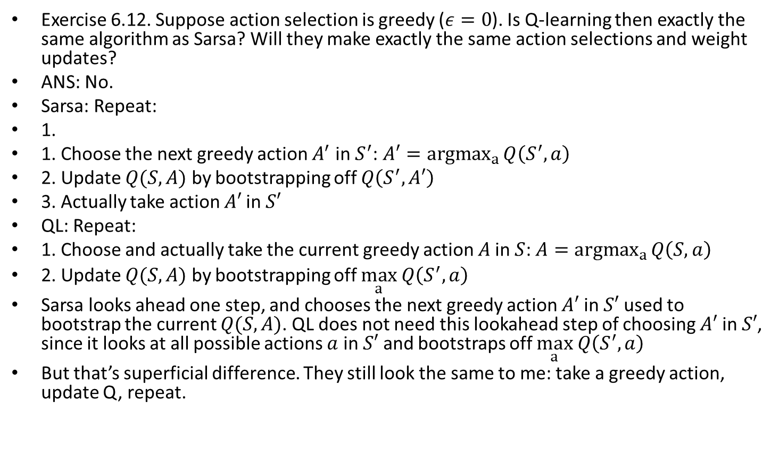
Sarsa and QL
Exercise 6.12. Suppose action selection is greedy ($ε=0$). Is Q-learning then exactly the same algorithm as Sarsa? Will they make exactly the same action selections and weight updates?
ANS: No.
Sarsa: Repeat:
1.
1. Choose the next greedy action $A^{′}$ in $S^{′}$: $A′={argmax}_{a}{Q\left(S^{′},a\right)}$
2. Update $Q(S,A)$ by bootstrapping off $Q\left(S^{′},A′\right)$
3. Actually take action $A′$ in $S′$
QL: Repeat:
1. Choose and actually take the current greedy action $A$ in $S$: $A={argmax}_{a}{Q\left(S,a\right)}$
2. Update $Q(S,A)$ by bootstrapping off $\max_{a} Q\left(S^{′},a\right)$
Sarsa looks ahead one step, and chooses the next greedy action $A′$ in $S′$ used to bootstrap the current $Q(S,A)$. QL does not need this lookahead step of choosing $A′$ in $S′$, since it looks at all possible actions $a$ in $S′$ and bootstraps off $\max_{a} Q\left(S^{′},a\right)$
But that’s superficial difference. They still look the same to me: take a greedy action, update Q, repeat.
Notes:
while behavior policy $b$ is more exploratoryand not necessarily equal to the a' selected to update Q
Sarsa updates it behavior policy during training, instead of using fixed behavior policy? Not PE, but GPI?
based on current policy $π$

Slide 10
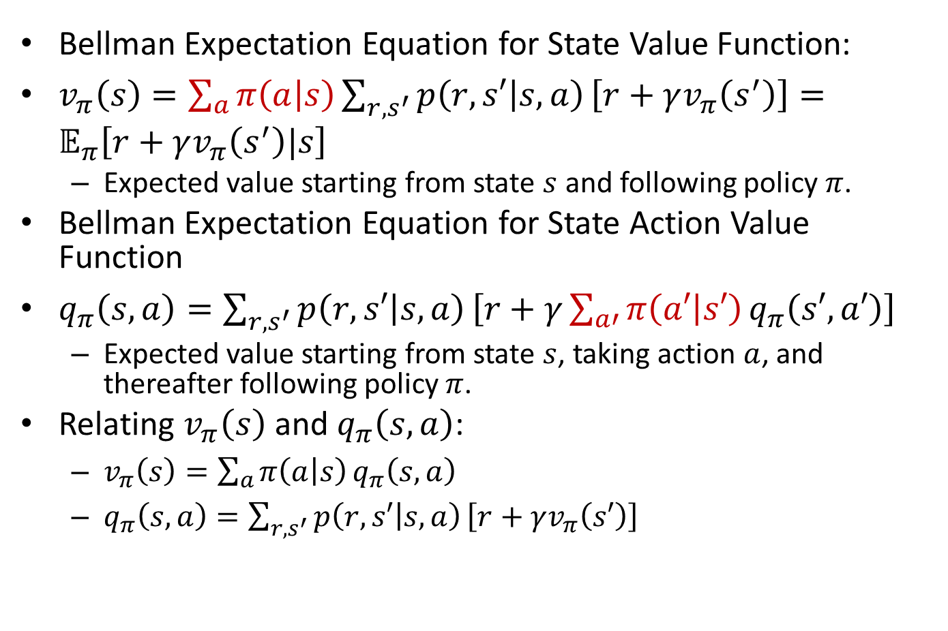
Bellman Expectation Equations
Important
Bellman Expectation Equation for State Value Function:
$v_{π}\left(s\right)=\sum_{a}{π\left(a | s\right)}\sum_{r,s^{′}}{p\left(r,s′ | s,a\right)}\left[r+γv_{π}\left(s^{′}\right)\right]=𝔼_{π}\left[r+γv_{π}\left(s^{′}\right)|s\right]$
Expected value starting from state $s$ and following policy $π$.
Bellman Expectation Equation for State Action Value Function
$q_{π}\left(s,a\right)=\sum_{r,s^{′}}{p\left(r,s′ | s,a\right)}\left[r+γ\sum_{a′}{π\left(a′ | s′\right)}q_{π}\left(s′,a′\right)\right]$
Expected value starting from state $s$, taking action $a$, and thereafter following policy $π$.
Relating $v_{π}\left(s\right)$ and $q_{π}\left(s,a\right)$:
$v_{π}\left(s\right)=\sum_{a}{π\left(a | s\right)}q_{π}\left(s,a\right)$
$q_{π}\left(s,a\right)=\sum_{r,s^{′}}{p\left(r,s′ | s,a\right)}\left[r+γv_{π}\left(s′\right)\right]$
Notes:
$=𝔼_{π}[R_{t+1}+γv_{π}(S_{t+1})|S_{t}=s]$ $=𝔼_{π}[R_{t+1}+γv_{π}(S_{t+1})|S_{t}=s, A_{t}=a]$

Slide 11
Quiz: Dijkstra’s, A*, Hybrid A*
Which of the following statements are true for Dijkstra’s algo, A*, Hybrid A*, respectively?
A. It is a continuous method.
B. It uses a heuristic function to guide node expansion.
C. It always finds a path if one exists.
D. The path it finds are guaranteed to be drivable.
E. The path it finds are guaranteed to be optimal (shortest).
ANS:
Dijkstra’s algo: C, E
A*: B, C, E
Hybrid A*: A, B, D

Slide 12
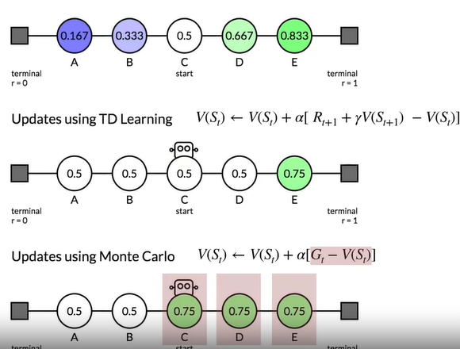

Slide 13
Lab2
Lab2: The cte() function should be changed to make it a round track shape. It is normal to have persistent large tracking errors at high speeds.
You did not change the track shape by modifying the cte() function.
Emphasize that the track shape must be a perfect circle.
It is an interesting idea to twiddle dt, but dt is supposed to stay constant during controller tuning, and frequent updates to dt during execution may not be a good idea.
Good report: Ellen Lindgren, Maurice Gerardus, Leila Methnani,

Slide 14
Lab 3 Comments
It depends on the complexity of your configuration, and that is why I said "do not make your environment more complex than necessary". I guess you just need to do trial and error, and try to make it work with the minimum number of vehicles possible. If you have too many vehicles, then training time may be too long. But if you have too few vehicles, then you are less likely to get into collisions.
https://www.canvas.umu.se/courses/2115/discussion_topics/39147
***including two configs that differ only in the lane_change_reward, one with no or rare collisions, one with frequent collisions.*** So if you get the two configs, you only need to show the 2 configs. You may need to try more configs, but we just want to see these two.
The training time depends on the complexity, i.e., number of vehicles. It does not have to be perfect training, as long as the differences among the 2 configs can be seen in the videos.

Slide 15
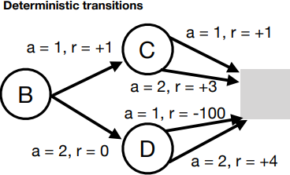
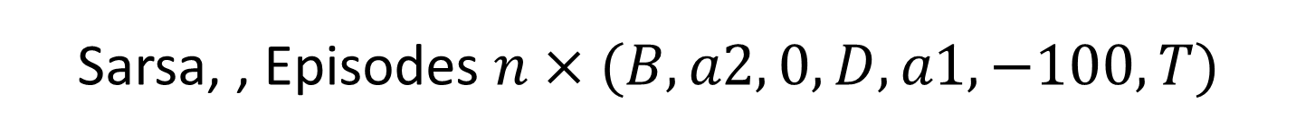

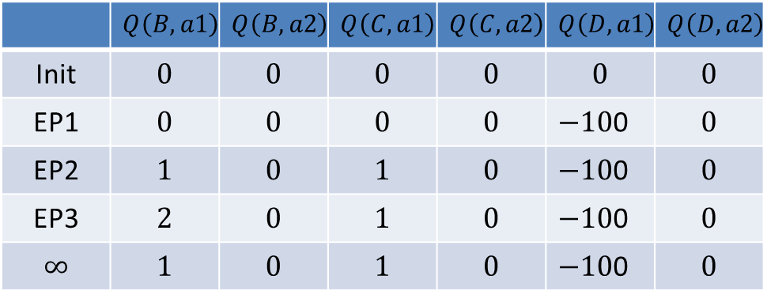
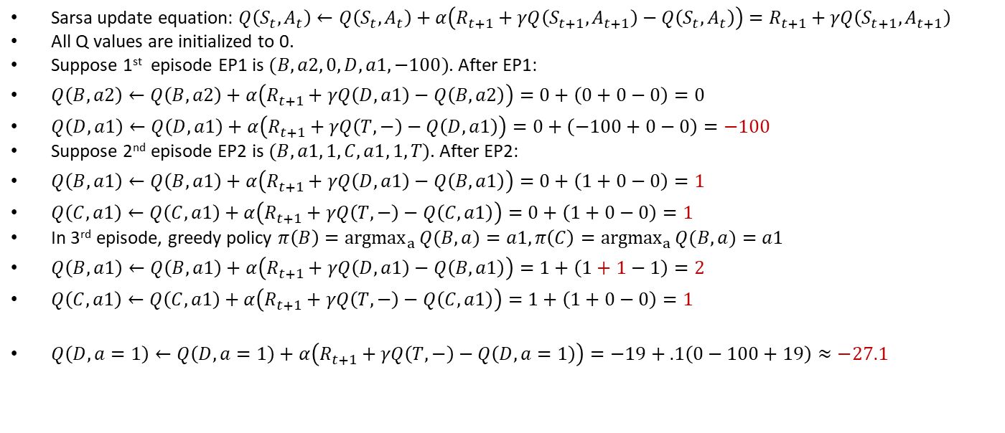
Sarsa, , Episodes $n×(B,a2, 0, D,a1,−100, T)$
Sarsa update equation: $Q\left(S_{t},A_{t}\right)←Q\left(S_{t},A_{t}\right)+α\left(R_{t+1}+γQ\left(S_{t+1},A_{t+1}\right)−Q\left(S_{t},A_{t}\right)\right)=R_{t+1}+γQ\left(S_{t+1},A_{t+1}\right)$
All Q values are initialized to 0.
Suppose 1st episode EP1 is $(B,a2, 0,D,a1,−100)$. After EP1:
$Q\left(B,a2\right)←Q\left(B,a2\right)+α\left(R_{t+1}+γQ\left(D,a1\right)−Q\left(B,a2\right)\right)=0+\left(0+0−0\right)=0$
$Q\left(D,a1\right)←Q\left(D,a1\right)+α\left(R_{t+1}+γQ\left(T,−\right)−Q\left(D,a1\right)\right)=0+\left(−100+0−0\right)=−100$
Suppose 2nd episode EP2 is $(B,a1, 1,C,a1, 1, T)$. After EP2:
$Q\left(B,a1\right)←Q\left(B,a1\right)+α\left(R_{t+1}+γQ\left(D,a1\right)−Q\left(B,a1\right)\right)=0+\left(1+0−0\right)=1$
$Q\left(C,a1\right)←Q\left(C,a1\right)+α\left(R_{t+1}+γQ\left(T,−\right)−Q\left(C,a1\right)\right)=0+\left(1+0−0\right)=1$
In 3rd episode, greedy policy $π\left(B\right)={argmax}_{a}{Q(B,a)}=a1,π\left(C\right)={argmax}_{a}{Q(B,a)}=a1$
$Q\left(B,a1\right)←Q\left(B,a1\right)+α\left(R_{t+1}+γQ\left(D,a1\right)−Q\left(B,a1\right)\right)=1+\left(1+1−1\right)=2$
$Q\left(C,a1\right)←Q\left(C,a1\right)+α\left(R_{t+1}+γQ\left(T,−\right)−Q\left(C,a1\right)\right)=1+\left(1+0−0\right)=1$
$Q\left(D,a=1\right)←Q\left(D,a=1\right)+α\left(R_{t+1}+γQ\left(T,−\right)−Q\left(D,a=1\right)\right)=−19+.1\left(0−100+19\right)≈−27.1$
$$T$$
 | $$Q\left(B, a1\right)$$ | $$Q\left(B, a2\right)$$ | $$Q\left(C, a1\right)$$ | $$Q\left(C, a2\right)$$ | $$Q\left(D, a1\right)$$ | $$Q\left(D, a2\right)$$
Init | $$0$$ | $$0$$ | $$0$$ | $$0$$ | $$0$$ | $$0$$
EP1 | $$0$$ | $$0$$ | $$0$$ | $$0$$ | $−10$0 | $$0$$
EP2 | $$1$$ | $$0$$ | $$1$$ | $$0$$ | $−10$0 | $$0$$
EP3 | $$2$$ | $$0$$ | $$1$$ | $$0$$ | $−10$0 | $$0$$
$$∞$$ | $$1$$ | $$0$$ | $$1$$ | $$0$$ | $−10$0 | $$0$$
Notes:
Assume greedy policy, i.e., $ε=0$ in $ε$-greedy action selection. so agent selects random actions in each state.

Slide 16
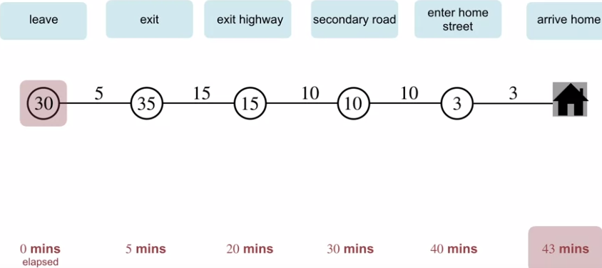
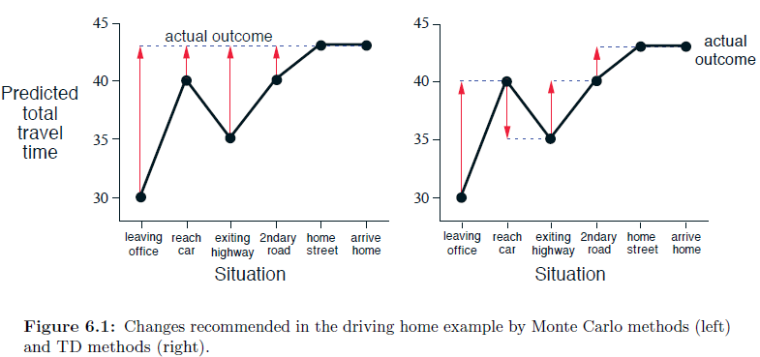
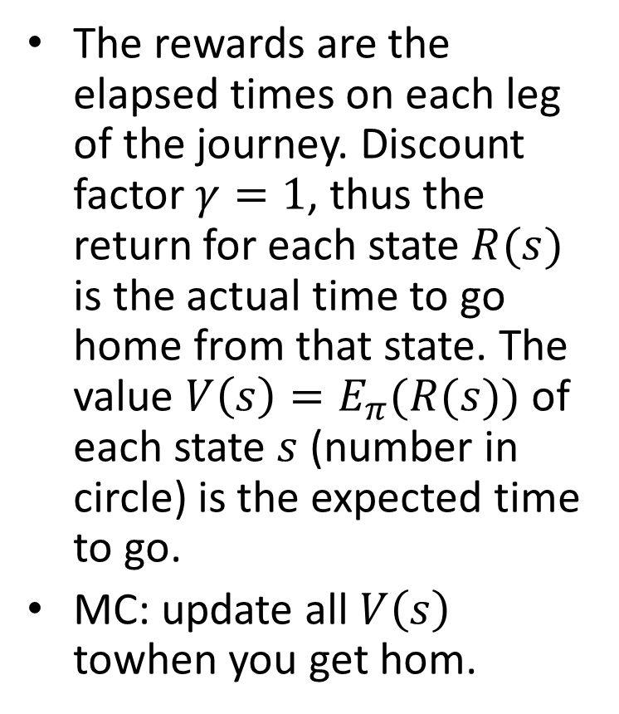
Example 6.1: Driving Home
The rewards are the elapsed times on each leg of the journey. Discount factor $γ=1$, thus the return for each state $R(s)$ is the actual time to go home from that state. The value $V\left(s\right)=E_{π}(R(s))$ of each state $s$ (number in circle) is the expected time to go.
MC: update all $V\left(s\right)$ towhen you get hom.

Slide 17
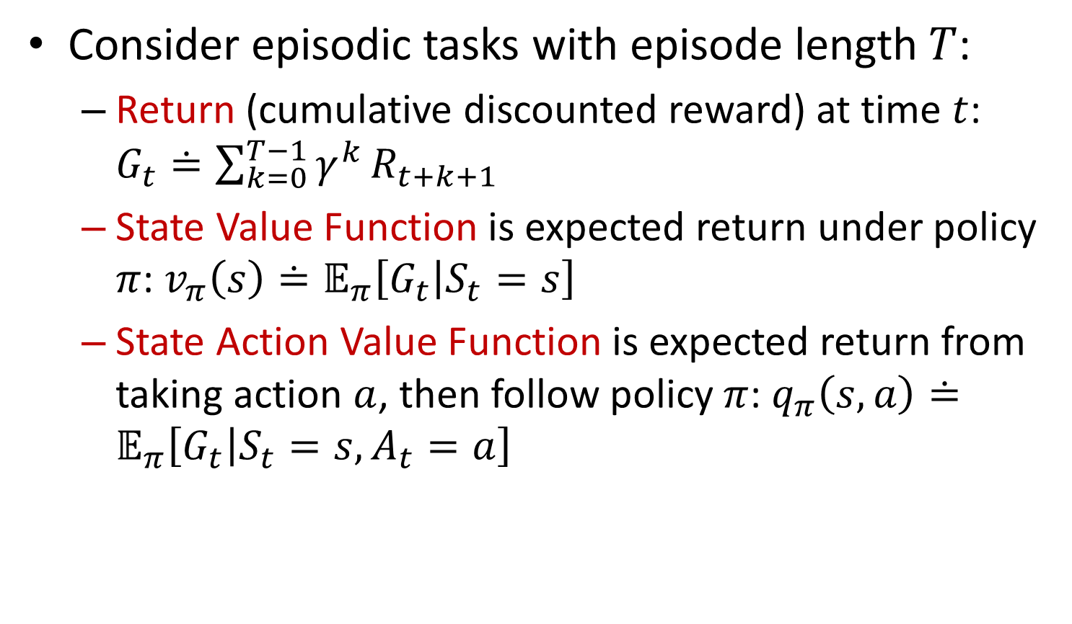
Return and Value Functions
Consider episodic tasks with episode length $T$:
Return (cumulative discounted reward) at time $t$: $G_{t}≐\sum_{k=0}^{T−1}{γ^{k}}R_{t+k+1}$
State Value Function is expected return under policy $π$: $v_{π}\left(s\right)≐𝔼_{π}\left[G_{t} | S_{t}=s\right]$
State Action Value Function is expected return from taking action $a$, then follow policy $π$: $q_{π}\left(s,a\right)≐𝔼_{π}\left[G_{t} | S_{t}=s,A_{t}=a\right]$

Slide 18
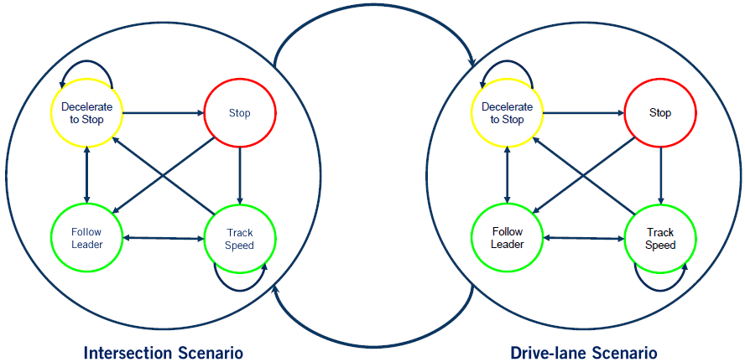
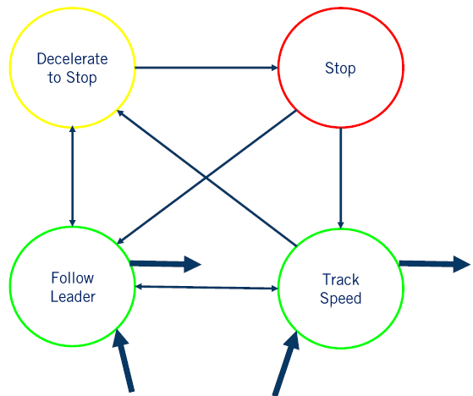
DELETE Handling Multiple Scenarios with Hierarchical FSM
Each driving scenario is modeled as a super-state, which contains a low-level FSM for the scenario.
(Each low-level FSM is specific for the scenario, e.g., the two FSMs in the figure have different trigger conditions not shown)
Exit
transitions
Entry transitions

Slide 19
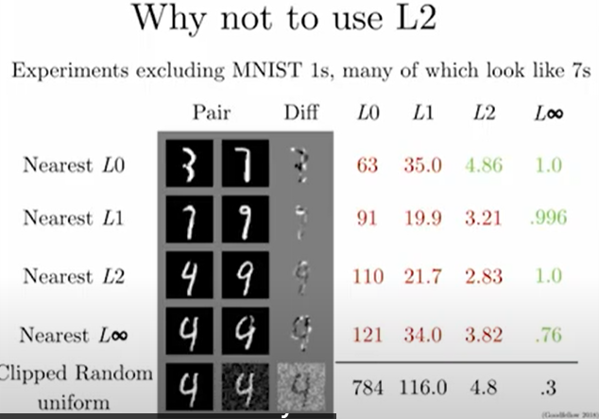
Defense Against the Dark Arts
https://www.youtube.com/watch?v=KNDkaVZwmg4&list=PL0pRF4xvoD0liEIWyJ6kmXqGT7nbr2L3u&index=11
Diagonal is minimum norm. Ideally, we want norm distance to be large for class-changing perturbations, small for random noise, like Linfty. But adding random noise leads to L2 norm 4.8, bigger than many class-changing perturbations. NG.
L2 norm cannot detect/permits change of a few pixels largely, which is likely to change the class.
We can make L2 distance big while still preserving the class

Slide 20
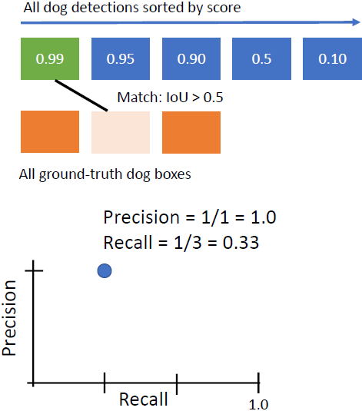
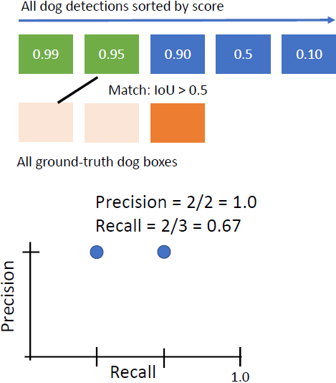
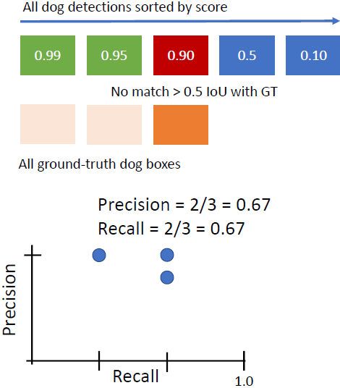

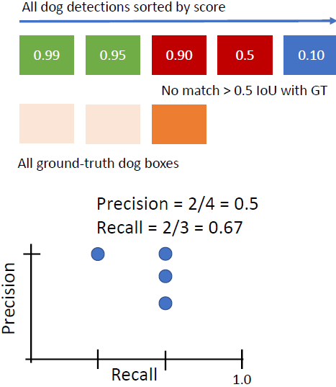
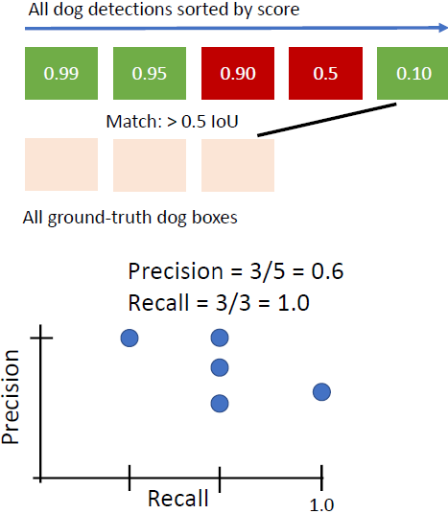
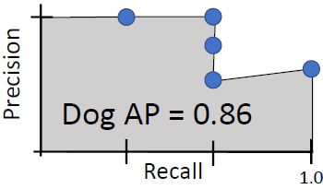
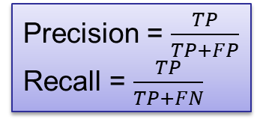
If you have a 3rd GT box that is not matched by any detection, then it is FN. But I don’t see any possible TN
FN=2 | TN=0
TP=1 | FP=0
FN=1 | TN=0
TP=2 | FP=0
FN=1 | TN=0
TP=2 | FP=1
FN=1 | TN=0
TP=2 | FP=2
FN=0 | TN=0
TP=3 | FP=2
Precision = $\frac{TP}{TP+FP}$
Recall = $\frac{TP}{TP+FN}$

Slide 21
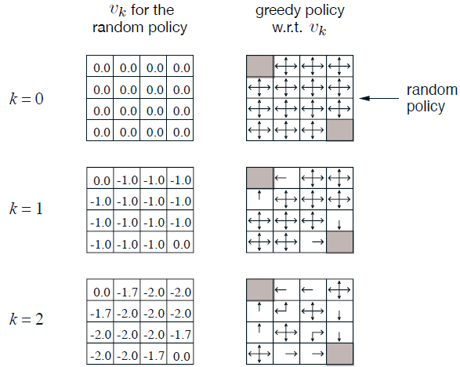
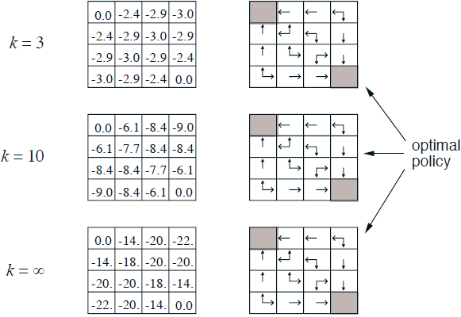
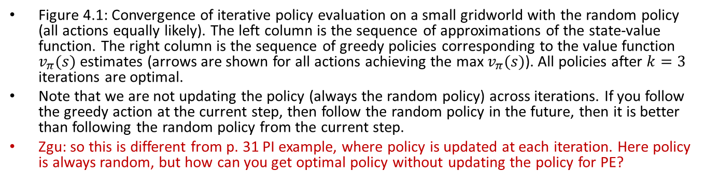
Iterative Policy Evaluation Results
Figure 4.1: Convergence of iterative policy evaluation on a small gridworld with the random policy (all actions equally likely). The left column is the sequence of approximations of the state-value function. The right column is the sequence of greedy policies corresponding to the value function $v_{π}(s)$ estimates (arrows are shown for all actions achieving the max $v_{π}(s)$). All policies after $k=3$ iterations are optimal.
Note that we are not updating the policy (always the random policy) across iterations. If you follow the greedy action at the current step, then follow the random policy in the future, then it is better than following the random policy from the current step.
Zgu: so this is different from p. 31 PI example, where policy is updated at each iteration. Here policy is always random, but how can you get optimal policy without updating the policy for PE?
Notes:
, and the numbers shown are rounded to two significant digits

Slide 22
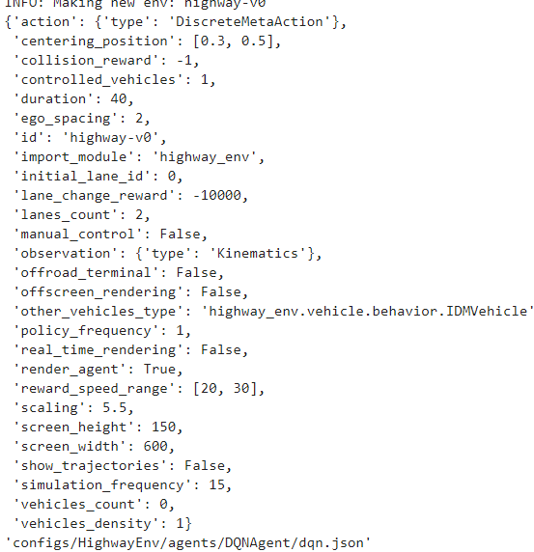
Lab3 Highway DQN rlagents
Not printed, why
"right_lane_reward": 0.1 "high_speed_reward": 0.4

